Slide 1

Time Interactive Notebook
Name
Class
Teacher
Term 3 Semester 2
1

Slide 2
Contents
Glossary or Formula Page
Page
Date
Description
2
3

Slide 3
Tasks
24
7
30
Essential Question
Questions
Notes
Summary
4
5

Slide 4
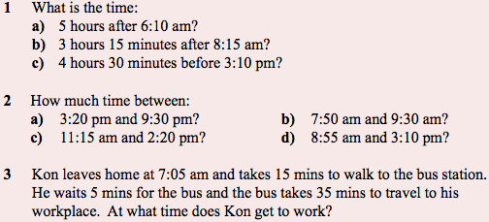
Warm up
Answer the following from last lesson:

Slide 5
24
7
30
Date
Time Zones
EQ – What are time zones and how do they affect our lives?
Summary:
5

Slide 6
Think/Pair/Share
Come up with 2 answers to the following question:
Why would it be important to be aware of the differences in time between different locations?

Slide 7
Time Zones Video
http://splash.abc.net.au/home#!/media/1950553/time-zones

Slide 8
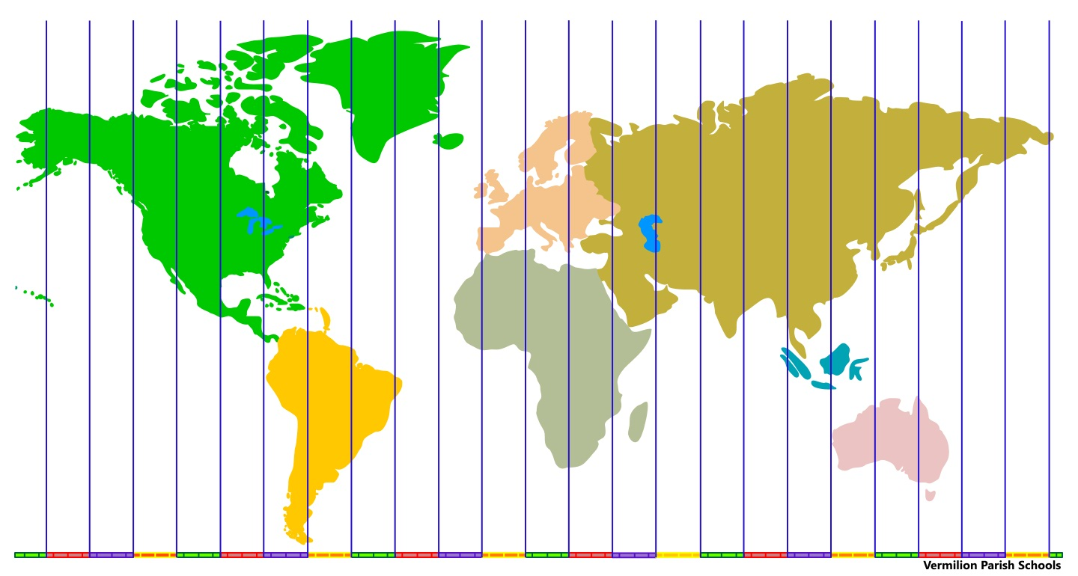
24
7
30
Date
Time Zones
EQ – What are time zones and how do they affect our lives?
Vocabulary
A time zone is a region of the earth that has the same time. There are 24 time zones.
5

Slide 9
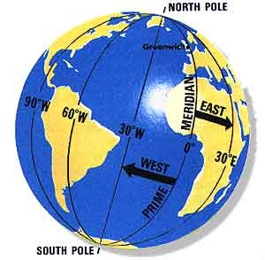
Greenwich, England is the starting point for time zones
The world rotates west to east (counterclockwise), time zones to the east are ahead of the those time zones to the west

Slide 10
LONGITUDE AND TIME
The world rotates (spins) _____° in ___ hours.
How many degrees per hour does the earth spin?
360° / 24 hours = 15° per hour
The world has 24 time zones, each 15° apart.
THERE IS A 1 HOUR TIME DIFFERENCE FOR EVERY 15° OF LONGITUDE (vertical lines on a map, similar to time zones)

Slide 11
24
7
30
Date
Time Zones
EQ – What are time zones and how do they affect our lives?
Think of it as a giant number line.
Greenwich, England is at 0 on the number line. As you move to the left you add, as you move to the right you subtract.
-2
Sandwich Islands
-1
Dakar
0
Greenwich
+1
Paris
+2
Cape Town
5

Slide 12
ANOTHER CHEESY SAYING
EAST INCREASE
Time is forward to all places to the east
WEST LESS
Time is backward to all places to the west
TASK: Fill out the following graphic organizer.
Remember: There are 24 total time zones and we start at 0 at Greenwich Mean Time and either +1 or -1 depending on the direction.

Slide 13
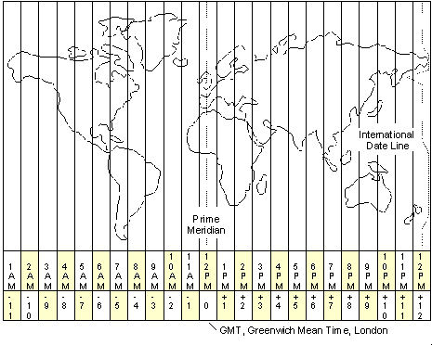
World Time Zones

Slide 14
What time is it in the locations below

Slide 15
Task:
Assume it is 11 am GMT (Greenwich Mean Time).
What time is it at each starred
point on your map of World Time Zones?

Slide 16
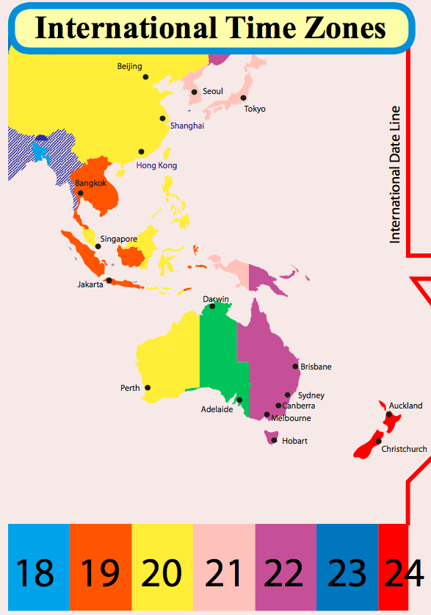

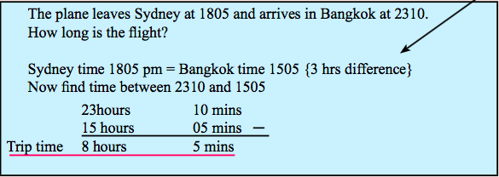
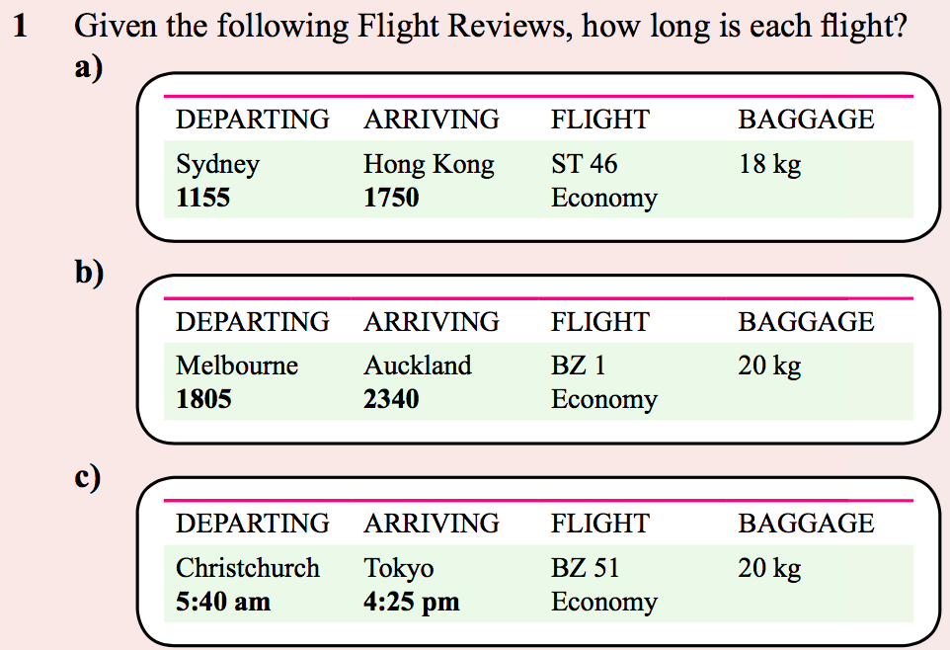
Pg. 196 Exercise 14.5 1 a,b,c
Example:
+ 10
+ 7
+ 6
+ 7
+ 8
+ 9
+ 10
+ 11
+ 12

Slide 17
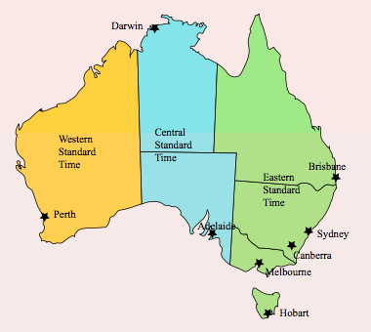
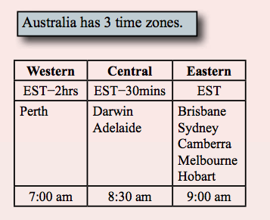
24
7
30
Date
Time Zones
EQ – What are the time zones in Australia?
Our Country…
Exactly how many time zones
does Australia have?
Summary:
5

Slide 18
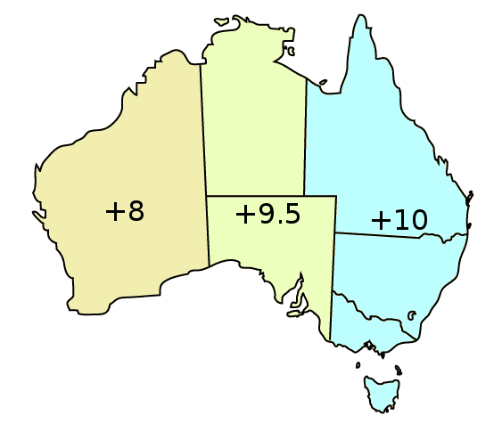
24
7
30
Date
Time Zones
EQ – What are the time zones in Australia?
Time zones are calculated in relation to GMT.
Greenwich Mean Time
For locations to our east we add time.
Sydney =
Adelaide + 30min
= 9am + 30min
= 9:30 am
Adelaide
9am
Sydney
9:30am
5

Slide 19
24
7
30
Date
Time Zones
EQ – What are the time zones in Australia?
Time zones are calculated in relation to GMT.
Greenwich Mean Time
For locations to our east we add time.
For locations to our west we subtract time.
Perth =
Adelaide – 1hr 30min
= 9am - 1hr 30min
= 7:30 am
Perth
7:30am
Adelaide
9am
5

Slide 20
24
7
30
Date
Time Zones
EQ – What are the time zones in Australia?
Example 1:
If the time in Sydney is 10 am, what is the time in Perth?
Perth =
Sydney – 2hr
= 10am – 2hr
= 8:00 am
Perth
8am
Sydney
10:00am
5

Slide 21
24
7
30
Date
Time Zones
EQ – What are the time zones in Australia?
Example 2:
If the time in Darwin is 4 pm, what is the time in Hobart?
Darwin
4pm
Hobart =
Darwin + 0.5hr
= 4pm + 0.5hr
= 4:30pm
5
Hobart
4:30pm

Slide 22
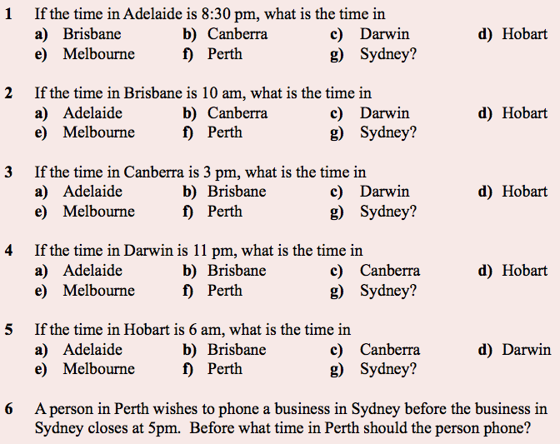
Page 194 1-6

Slide 23

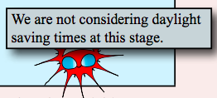
24
7
30
Date
Time Zones
EQ – What are the time zones in Australia?
Example 3: A plane leaves Brisbane at 7:55pm and arrives in Adelaide at 9:50pm? How long is the flight (Brisbane and Adelaide are in different time zones)
Brisbane time 7:55pm = Adelaide time 7:25 pm (30 min time difference)
Now find time difference between
7:25pm and 9:50pm
Brisbane
7:55pm
Adelaide
5
9:50pm

Slide 24
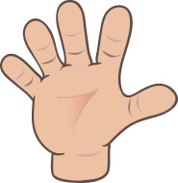
Do you understand? Fists of Five
Notes:
Check for Understanding

Slide 25

Now your turn
Have a go at page 195 in your textbook
Left Hand Side

